Slide 1
refined content, maybe pare it down
getting their feedback
live polling at the beginning of the session
go through york's stuff - schedule a meeting for later next week or week after
hone it in, and cut

Slide 2
Building Blocks of Blockchain
Hyland Hy-Tech Camp

Slide 3
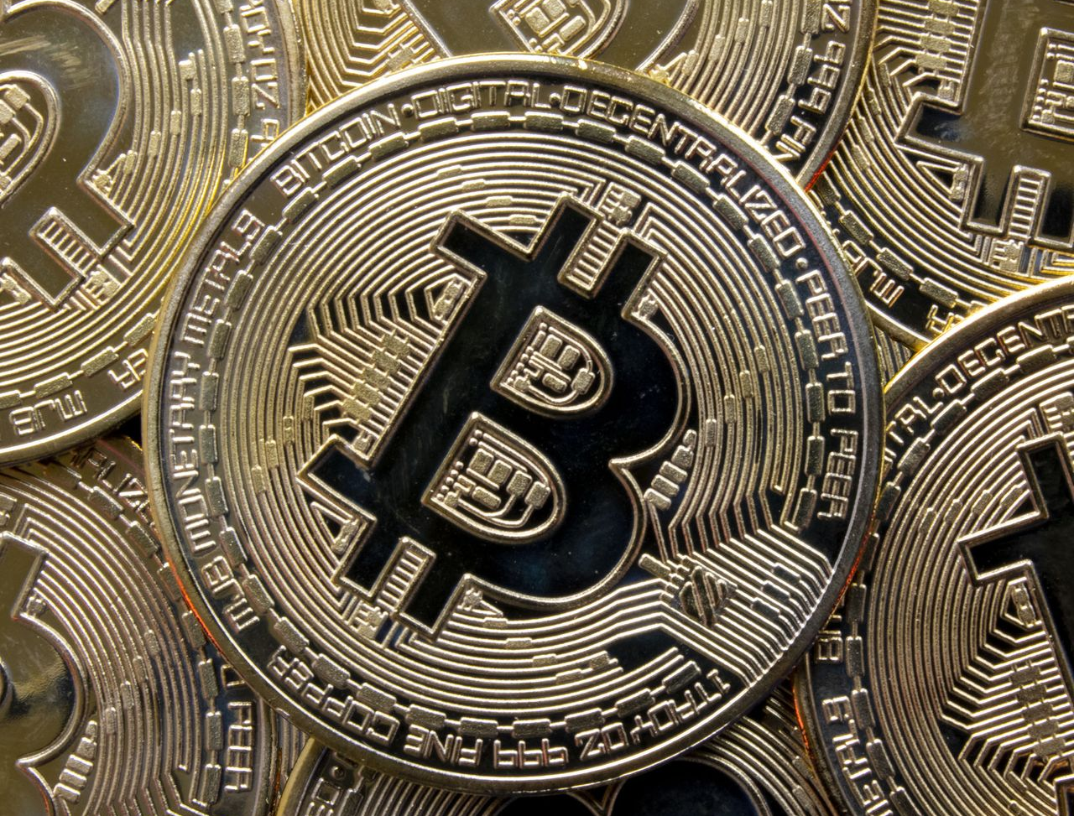
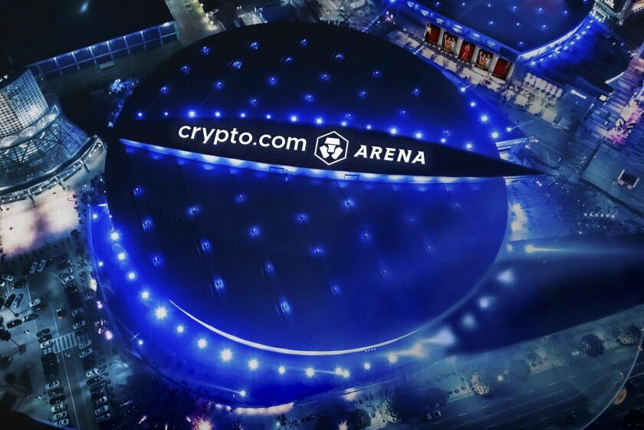
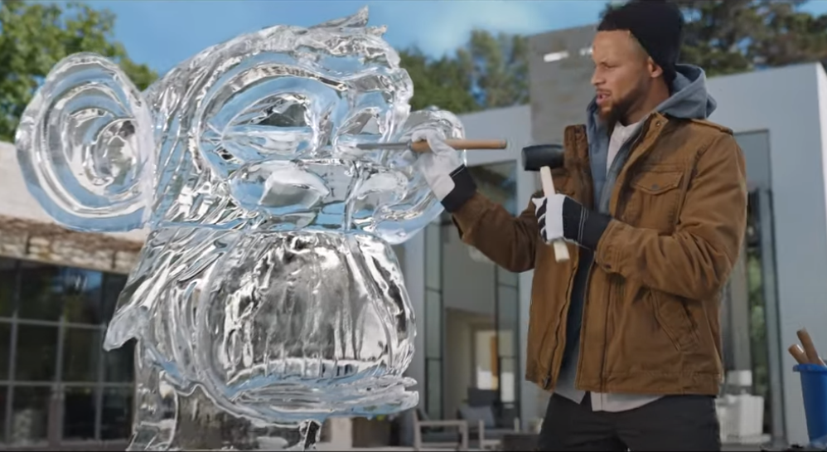

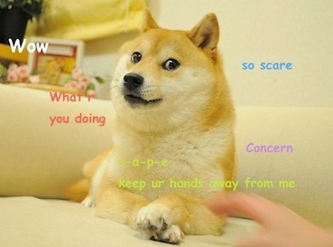

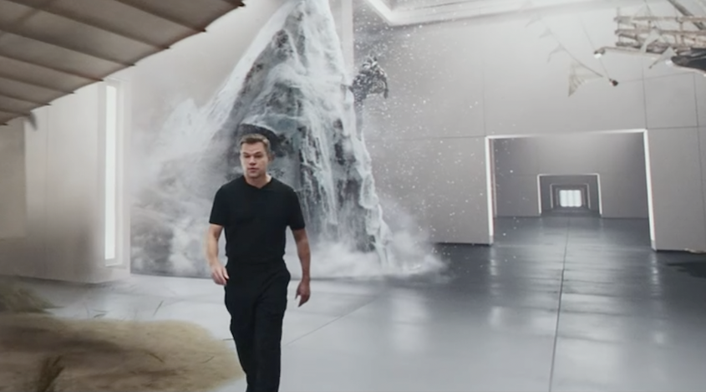
Cultural Perceptions
Notes:
Poll the room to see how many students have heard of blockchain, bitcoin, cryptocurrency, NFTs
Ask the students if they know what these things are
Bitcoin is a Cryptocurrency – you might have heard about it as an investment.
Ask if students recognize this shiba inu – it’s the mascot of a memecoin called Dogecoin.
Does anyone know where the Lakers play? They used to play at the Staples Center, but the name recently changed to crypto.com.
You may have seen the Matt Damon super bowl ad for the same company – it’s a Cryptocurrency exchange.
Maybe you’ve seen this FTX ad featuring Steph Curry – or maybe you recognize the ice sculpture he’s building (Bored Ape Yacht Club NFTs)
You may have seen pictures like this pixelated person – they are NFTs, basically digital assets than can be owned and traded.
Another example of NFTs is NBA Top Shot – basically virtual trading cards

Slide 4
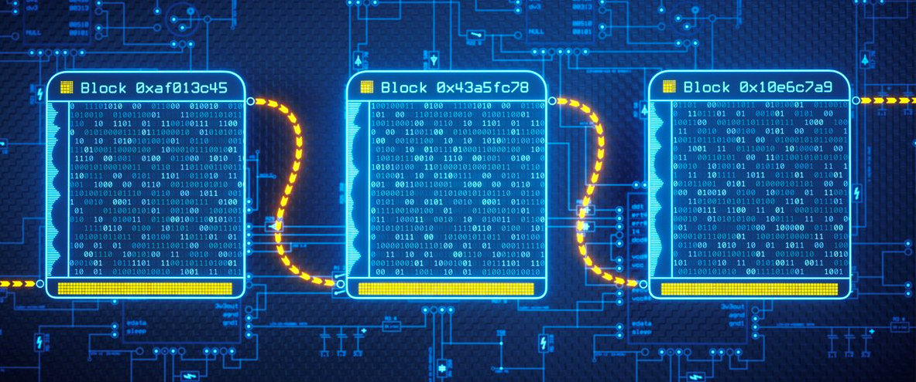
Blockchain: The Technology Behind It All
A blockchain is an immutable ledger for recording transactions, tracking assets, and building trust
It is the technology behind cryptocurrencies and NFTs
Although it originated with bitcoin, its applications are much farther reaching
Notes:
Go over the definition of blockchain – this will be covered more in-depth later on, so no need to over-explain
Biggest thing is that blockchain is the underlying technology that makes things like cryptocurrency and NFTs possible
It started with Bitcoin (more on that later), but there is a lot more that it can do

Slide 5
The History of Blockchain
Where does it come from?
Notes:
Get into some of the history of blockchain – if students remember from the previous slide, it all started with bitcoin

Slide 6
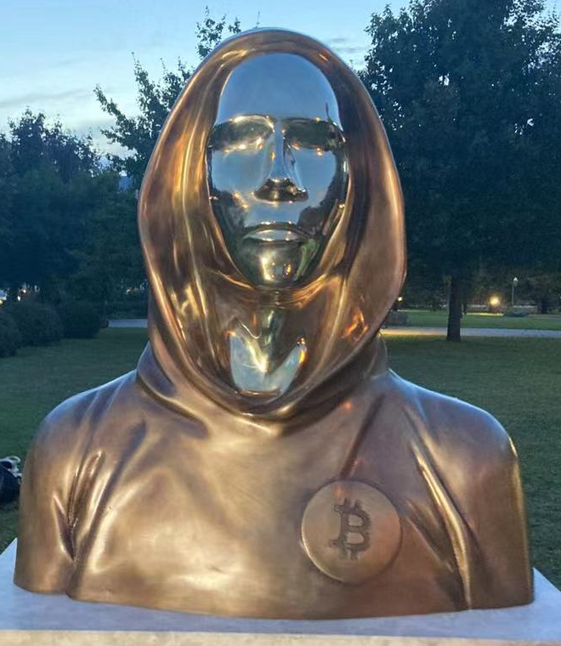
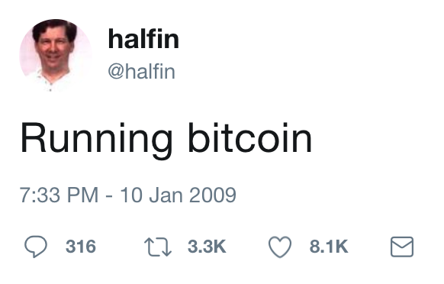

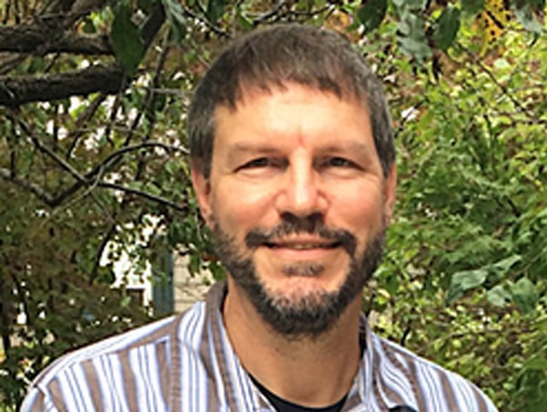
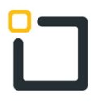
Bitcoin & Satoshi Nakamoto
What is a cryptocurrency?
A digital currency designed to work as a medium of exchange through a computer network that is not reliant on any central authority, such as a government or bank, to uphold or maintain it.
How did it start?
Jan 4, 2008 – bitcoin.org registered
Oct 31, 2008 – white paper posted
Jan 3, 2009 – genesis block
Who is Satoshi Nakamoto?
Hal Finney
Dorian Nakamoto
Nick Szabo
Notes:
Ask the students what they think a cryptocurrency is
Reveal the definition, and call out the key points – it’s a digital currency, and it’s decentralized
Go through some of the early events – how it all began
Jan 4, 2008 is when the domain name was registered
Halloween 2008 is when a mysterious whitepaper appeared, authored by a pseudonymous person (or group of people) named Satoshi Nakamoto
This whitepaper contained the technical details involved in implementing the first ever blockchain – upon which bitcoin would be based
It was posted to a cryptography mailing list
The identity of Satoshi is still unknown to this day – there are some people it might be:
Hal Finney, first receiver of a Bitcoin transaction – tweeted “Running bitcoin on 10 Jan 2009”
Dorian Nakamoto (born Satoshi Nakamoto) – probably just a coincidence
Nick Szabo – stylometric analysis (i.e., writes in the style of the bitcoin whitepaper), published a paper on “bit gold” (precursor to bitcoin)
Could be a group of people
We will probably never know
Whoever Nakamoto is, on Jan 3, 2009, the Bitcoin genesis block was created

Slide 7
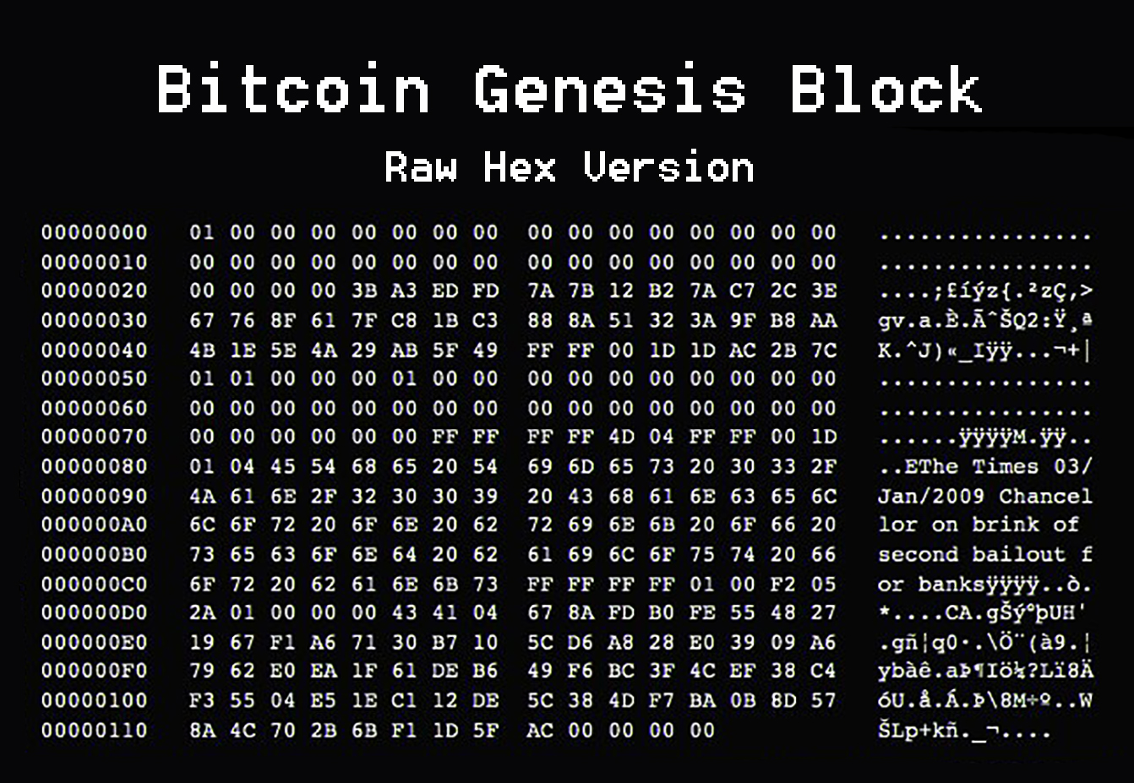
Jan 3, 2009 – Blockchain Arrives
Bitcoin block number 0
50BTC ($1.5mil in 2022)
Not-so-hidden message
Why use blockchain?
Trustless
No central authority
Like physical cash
Secure, immutable
Open source, grassroots
Notes:
The “genesis block” for a blockchain is simply the first block mined (or, block number 0)
The reward for mining this block was 50 BTC (or about 1.5 million in 2022)
Ask the students if they can find the hidden message in the block
“The Times 03/Jan/2009 Chancellor on the brink of second bailout for banks” – referring to a headline from a newspaper about banks
Ask the students why they think Nakamoto would put this in the block
The message could give us a hint to Nakamoto’s identity, and definitely to his motive
Get into some of the “why” of blockchain
As opposed to big banks that can be unstable, Nakamoto may have believed that the trustlessness of blockchain would be better
Bitcoin would not have a central authority – this is meant to give individuals more power
It could act kind of like digital “cash” – peer-to-peer spending, without identity needed
We’ll get into it a bit more, but security was a big part of it
Many early adopters were in the cryptography space – the entire technology is based on cryptography, which is a big part of security
The immutability of the ledger means that all transactions will live forever, and can always be traced
It’s open source nature led to a focus on community-driven development – individual people, working together to create something new
It’s kind of inspiring that they did this in such a grass-roots way!
https://www.investopedia.com/news/what-genesis-block-bitcoin-terms/

Slide 8
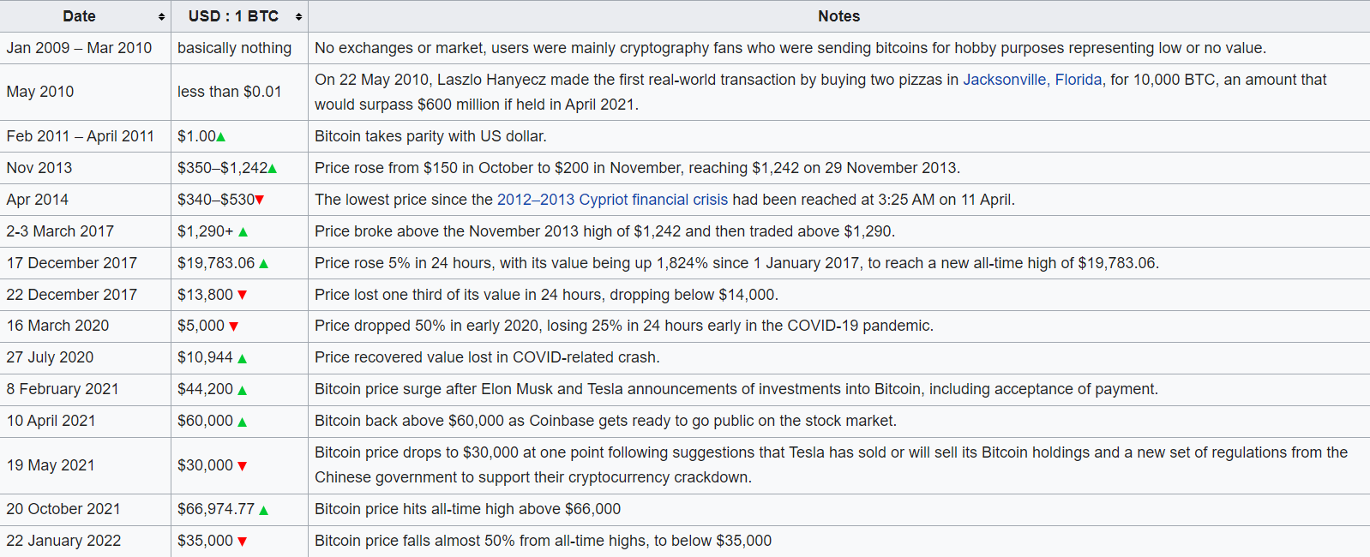
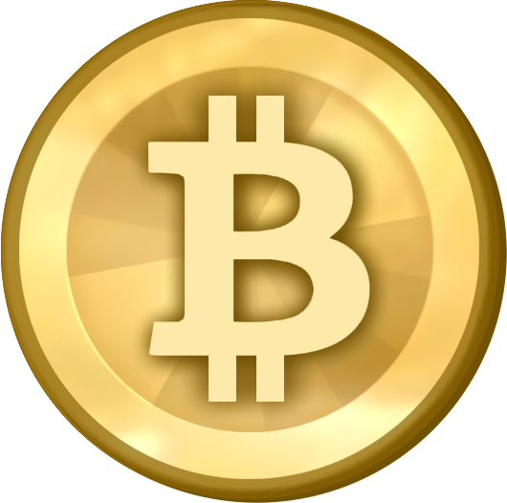
Bitcoin Value History
Date
Jan 2009-Mar 2010
Value in $
basically nothing
Notes
No exchanges or market, users were mainly cryptography fans who were sending bitcoins for hobby purposes representing low or no value.
Notes:
https://en.wikipedia.org/wiki/History_of_bitcoin
Talk about the growth of bitcoin and how blockchain technology grew along with it

Slide 9
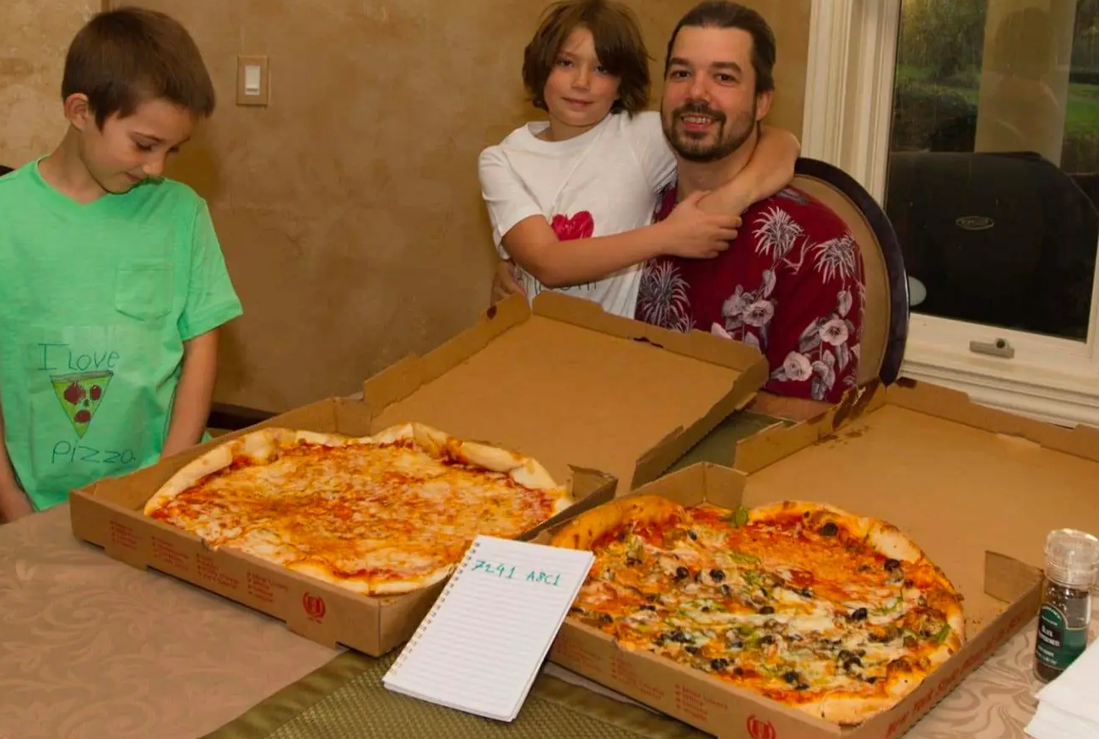
Bitcoin Value History
Date Value in $
May 22, 2010 Less than $0.01
Notes
Laszlo Hanyecz made the first real-world transaction by buying two pizzas in Jacksonville, Florida, for 10,000 BTC, an amount that would surpass $680 million if held in November 2021.
Notes:
https://en.wikipedia.org/wiki/History_of_bitcoin

Slide 10
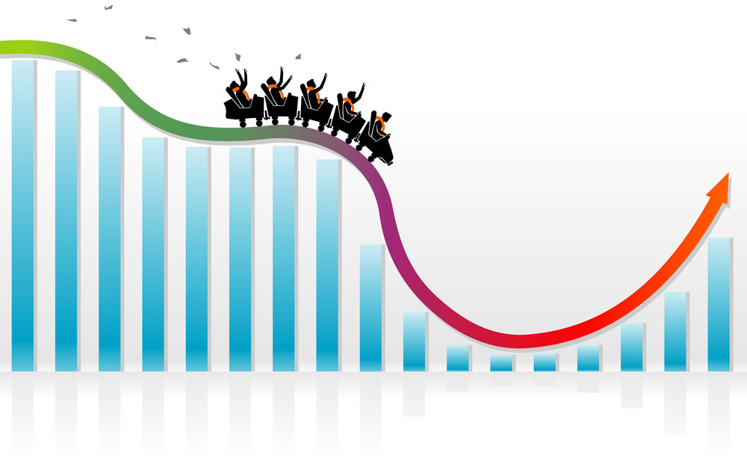
Bitcoin Value History
Date
Nov 2013-Present
Value in $
Extremely Volatile
Notes
Financial Crisis
COVID-19
Elon Musk/Tesla
Coinbase
Other Factors?
Notes:
https://en.wikipedia.org/wiki/History_of_bitcoin
Mention that in the present, El Salvador has bitcoin as a national currency (for better or worse)

Slide 11
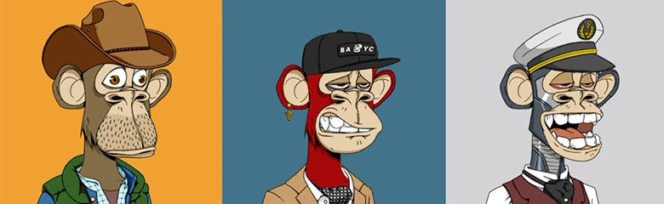


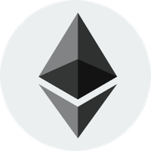
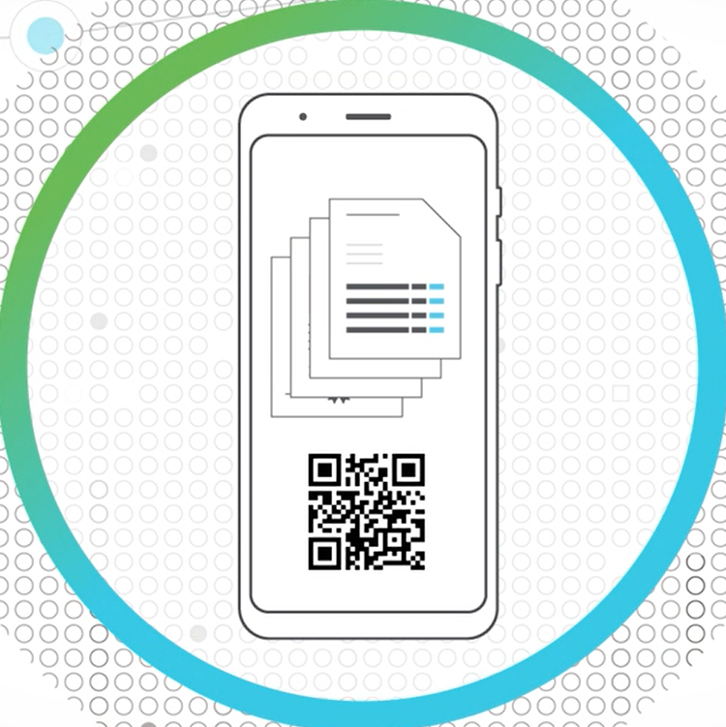
Blockchain Beyond Bitcoin
2014: Blockchain 2.0
More widely available
Investment from companies like IBM, Microsoft
Dapps
Decentralized applications
Back-end code does not run on a central server
Data integrity, privacy, built-in payments
NFTs
Non-fungible tokens (unique)
Digital ownership (spec assets)
Thousands of Cryptocurrencies
Tether – Stablecoin
Dogecoin – Memecoin
Ethereum – Smart contracts
Hyland Credentials
Government of Malta – nationwide initiative for education certificates
Notes:
2014 was the beginning of what’s known as “Blockchain 2.0” – basically moving beyond the basics of a cryptocurrency
It became more widely available as a technology
There was investment from companies like IBM and Microsoft
Since around then, there have been a lot of new cryptocurrencies (thousands, in fact)
One interesting one is Tether – it’s what’s known as a “stablecoin” – its value is meant to be tied to another currency
And of course, there are memecoins like Dogecoin – which has had some ups and downs
There is also Ethereum – the big thing there was that it introduced smart contracts (we’ll talk more about that later)
One thing Ethereum does is power Dapps
These are decentralized applications
Instead of back-end code running on a central server, it runs on the blockchain
Dapps have features like data integrity due to the immutable nature of the blockchain, privacy/anonymity/security, and built-in payments using Ether (Ethereum’s currency)
Another technology powered by blockchain is NFTs
Non-fungible tokens – each one is completely unique
It’s a way to basically own something digitally… ex, anyone can buy a Monet print (download a jpeg), but only one person can own the original (have the nft)
They are kind of like digital trading cards, but only one exists
Could be used to verify ownership or creatorship of art, music – preventing plagiarism
Can also be used for scams and just speculative value
One final example here – Hyland Credentials is Hyland’s blockchain-backed credentialing technology
The government of Malta is a customer – they used this technology to issue education certificates across the country
Falsifying student transcripts is an issue, and this helps with automation
There are other uses too, like supply chain management, food contamination tracking, and more. This is just scratching the surface!
https://www.oreilly.com/library/view/blockchain/9781491920480/ch02.html
https://www.hyland.com/en/platform/product-suite/hyland-credentials/higher-education

Slide 12
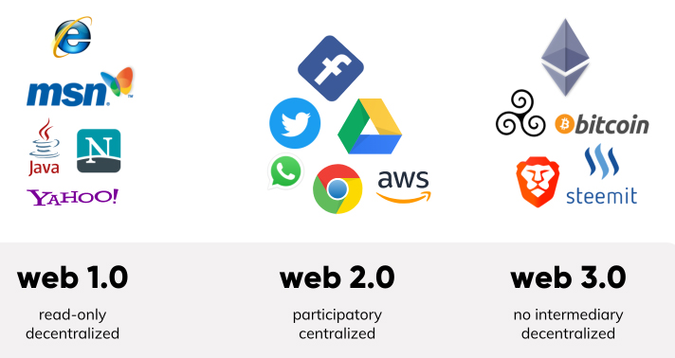
? Blockchain & The Web
Web 1.0, Web 2.0, Web 3.0 (value, identity, persistence)
Visualizations
Acceleration of technology, the speed at which things change
How impactful is the internet
https://www.martechalliance.com/stories/whats-the-difference-between-web-1.0-web-2.0-and-web-3.0

Slide 13
Blockchain Architecture
How does a blockchain actually work?
Notes:
Diagram using people in the room, everyone is a node – interactive thing, drop in the use of smart contracts, cryptocurrency

Slide 14
Basics
A ledger
Transactions on blocks, everyone in the network has a copy of the chain, cannot change previous blocks
Immutable
Decentralized
Trustless
Notes:
https://www.youtube.com/watch?v=bBC-nXj3Ng4
https://jis-eurasipjournals.springeropen.com/articles/10.1186/s13635-019-0085-3

Slide 15
Cryptography
SHA256 Hash – Cryptographic Hash Function
Public/Private Key Pairs for digital signatures
Nonces

Slide 16
Mining Cryptocurrency
What is mining
Proof of work
Miners = Block Creators who receive a Block Reward
Bitcoin as an example – evolution of difficulty over time to maintain 1 block per 10 minutes, also block reward has been updated over time to ensure there is only a limited number of bitcoin over time – economically,
Hash starting with a bunch of 0s (like 76) – one in 75 sextillion chance
Block Explorer https://www.blockchain.com/btc/blocks?page=1 (show them at the end maybe)
https://www.blockchain.com/btc/block/1
https://www.blockchain.com/charts#mining
Notes:
https://bitcoin.stackexchange.com/questions/1781/nonce-size-will-it-always-be-big-enough
Difficulty: https://bitcoin.stackexchange.com/questions/16687/solo-mining-just-for-luck-realistic

Slide 17
Interactive Demo
https://andersbrownworth.com/blockchain/
Notes:
Finding leading 0s, like checking your work in math

Slide 18
Ethereum & Smart Contracts
How can you develop a blockchain app?

Slide 19
Ethereum v. Bitcoin
What is Ethereum?
What makes it different from bitcoin? BTC as a cryptocurrency v. Ethereum as a smart contract platform that’s programmable
Coin in arcade machine to play the game -> smart contract analogy
Microtransactions
Keep it high level
Remix – Ethereum IDE
Cryptozombies can write code for you
Notes:
Different block creation time
Blockchain is not just cryptocurrencies

Slide 20
dApps
What are dApps? Decentralized Apps
What is the purpose?
Examples: token swaps, games, investments
https://ethereum.org/en/dapps/

Slide 21
Smart Contracts & Solidity
Smart contracts are business logic on the blockchain itself
Solidity is a programming language for smart contracts
Transactions cost gas
Why? No mental transactions, more predictable, completely unambiguous (unlike the law)

Slide 22
Blockchain & Society
How does blockchain impact the world?

Slide 23
Controversy: Crypto-Bubble
Wikipedia has stopped taking crypto donations – Extremely risky + inherently predatory
Unregulated market – first type of digital asset… dangerous, but government is thinking about it
“Best place to invest in crypto is in your knowledge.” Technology is not going away, will be leveraged in the infrastructure layers of global computing into the future
Kind of like databases
Notes:
https://finance.yahoo.com/news/extremely-risky-inherently-predatory-wikipedia-110040373.html

Slide 24
Controversy: The Environment
Mozilla has stopped taking crypto donations
Tesla has stopped taking Bitcoin payments (causing the value to plummet)
Ethereum is moving to proof-of-stake https://ethereum.org/en/energy-consumption/
Other types of networks that are more cost effective, different consensus algorithms, many initiatives to make it more environmentally friendly, easier to maintain
Crypto is a bit like the wild west at this point
EU, Singapore making their own networks
Texas – solar plants to do crypto mining
Bitcoin mining – monetize the excess energy on a network, sell bitcoin to monetize creation of the electrical grid. Turn off mining when the network needs the energy. Normalize the network load
Notes:
https://techcrunch.com/2022/01/06/mozilla-foundation-crypto/?guccounter=1&guce_referrer=aHR0cHM6Ly9maW5hbmNlLnlhaG9vLmNvbS9uZXdzL2V4dHJlbWVseS1yaXNreS1pbmhlcmVudGx5LXByZWRhdG9yeS13aWtpcGVkaWEtMTEwMDQwMzczLmh0bWw&guce_referrer_sig=AQAAAH6Sc90lcZaPvLxsYHkWzOHjL6BKzxBIfKjOK6cXTt_1TeGBuLdGus-_Sldwym358vzVc9sCed60iIoJWWIsobsJq6QnATYhCK6uaq4RBJdgch5sykTtBLq7EwhPoAqu0Llz4HDTvGTCL_goH6h3asoutcrWAnhWv7O7WAmBzU_7
https://fortune.com/2021/05/12/bitcoin-plunges-elon-musk-tesla-car-purchases/

Slide 25
Controversy: Crime
Rug pulls
51% attack
Bored ape yacht club hack - https://www.coindesk.com/tech/2022/04/25/at-least-13m-in-nfts-stolen-after-bored-ape-yacht-club-instagram-discord-hacked/
Malware locking – require to pay bitcoin
Incentivizes hackers more, and they can stay pseudo-anonymous
Transparency of Bitcoin – can track every single transaction back to the beginning. Auditability – can see the money when it’s stolen – in perpetuity forever
FBI recovered millions of dollars of bitcoin that was stolen years ago - https://www.wsj.com/articles/how-the-fbi-got-colonial-pipelines-ransom-money-back-11623403981
Notes:
Including rug pulls

Slide 26
Gartner Hype Cycle

Slide 27
Summary
Wrapping things up
Notes:
Ask the students for some take-aways from the presentation

Slide 28
THANK YOU!
WHAT QUESTIONS DO YOU HAVE?

